Slide 1
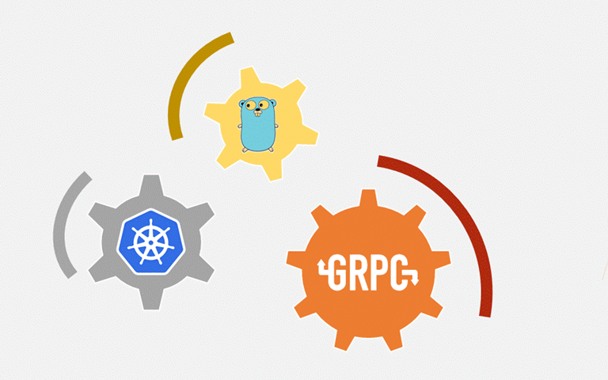
CodeSeeker
gRPC SETUP ON UBUNTU

Slide 2
CodeSeeker
Login to your Ubuntu system and open terminal .
gRPC requires Go 1.6 or higher. first check the version.
----> go version
Use the following command to install gRPC:
----> go get -u google.golang.org/grpc

Slide 3
CodeSeeker
Install Protocol Buffers v3 :
Install the protoc compiler that is used to generate gRPC service code. The simplest way to do this is to download pre-compiled binaries for your platform(protoc-<version>-<platform>.zip) from here:
open web browser and search the below reference and dowload .
reference :
https://github.com/google/protobuf/releases
In this web page Download the "protoc-3.9.1-linux-x86_64.zip” file...
next unzip and rename as protoc and copy whole protoc folder in go/bin.

Slide 4
CodeSeeker
Next, install the protoc plugin for Go
----> go get -u github.com/golang/protobuf/protoc-gen-go
The compiler plugin, protoc-gen-go, will be installed in $GOBIN, defaulting to $GOPATH/bin. It must be in your $PATH for the protocol compiler, protoc, to find it.
----> export PATH=$PATH:$GOPATH/bin

Slide 5
CodeSeeker
Build the example:
Change to the example directory
----> cd $GOPATH/"installed go path"/src/google.golang.org/grpc/examples/helloworld
gRPC services are defined in a .proto file, which is used to generate a corresponding .pb.go file. The .pb.go file is generated by compiling the .proto file using the protocol compiler: protoc.
For the purpose of this example, the helloworld.pb.go file has already been generated (by compiling helloworld.proto), and can be found in this directory: $GOPATH/src/google.golang.org/grpc/examples/helloworld/helloworld
This helloworld.pb.go file contains:
Generated client and server code.
Code for populating, serializing, and retrieving our HelloRequest and HelloReply message types.

Slide 6
CodeSeeker
Try it!:
To compile and run the server and client code, the go run command can be used. In the examples directory:
----> go run greeter_server/main.go
From a different terminal:
----> go run greeter_client/main.go
If things go smoothly, you will see the Greeting: Hello world in the client side output.

